Slide 1

Gmail Automated Workflow (n8n)
By Gehad Ahmed Elberady

Slide 2
Problem & Motivation
Receiving CVs or requests via email can be tedious.
Manual handling is error-prone and time-consuming.
Need for automation to save time and organize files efficiently.

Slide 3
Solution
utomated workflow using n8n.
Emails with attachments are processed automatically.
Attachments are uploaded to Google Drive.
Optional confirmation emails sent to sender.

Slide 4

Technologies Used
n8n → workflow automation
Gmail → receive emails
Google Drive → store attachments
Gmail → send confirmation emails

Slide 5
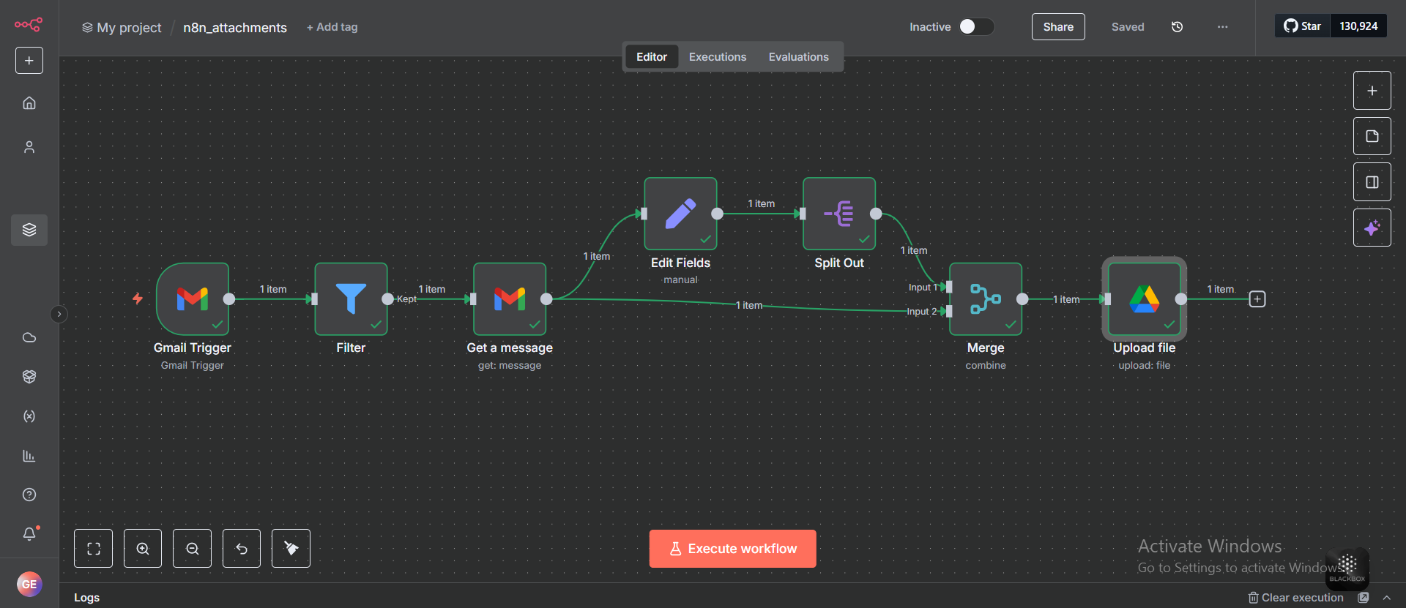
Demo & Screenshots

